Slide 1
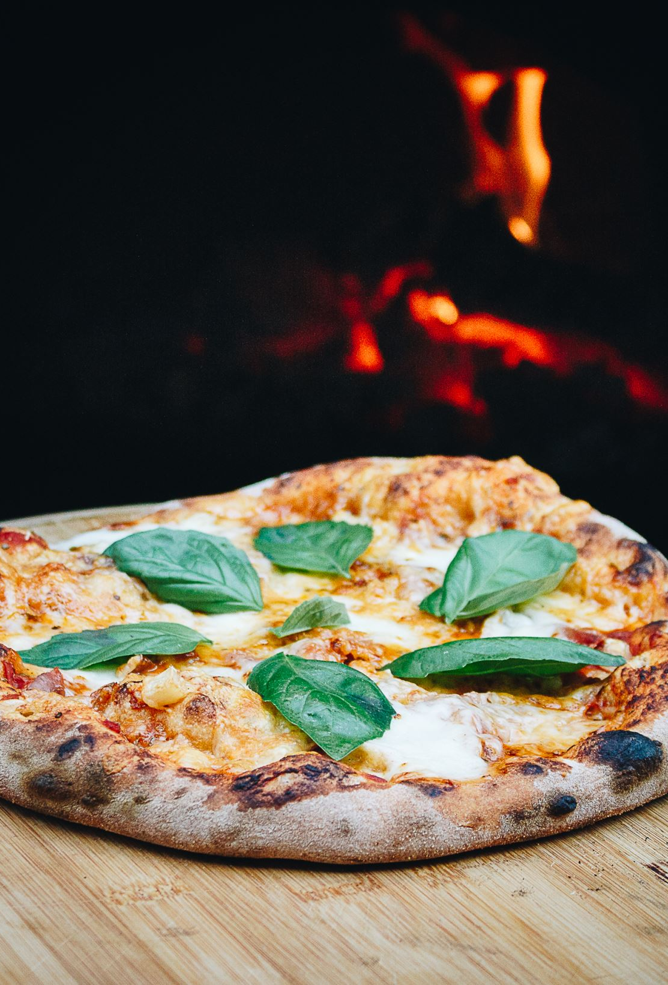
Pizza Automat
Serhat DAL 210702027
Yusuf ÖZESER 210702015

Slide 2
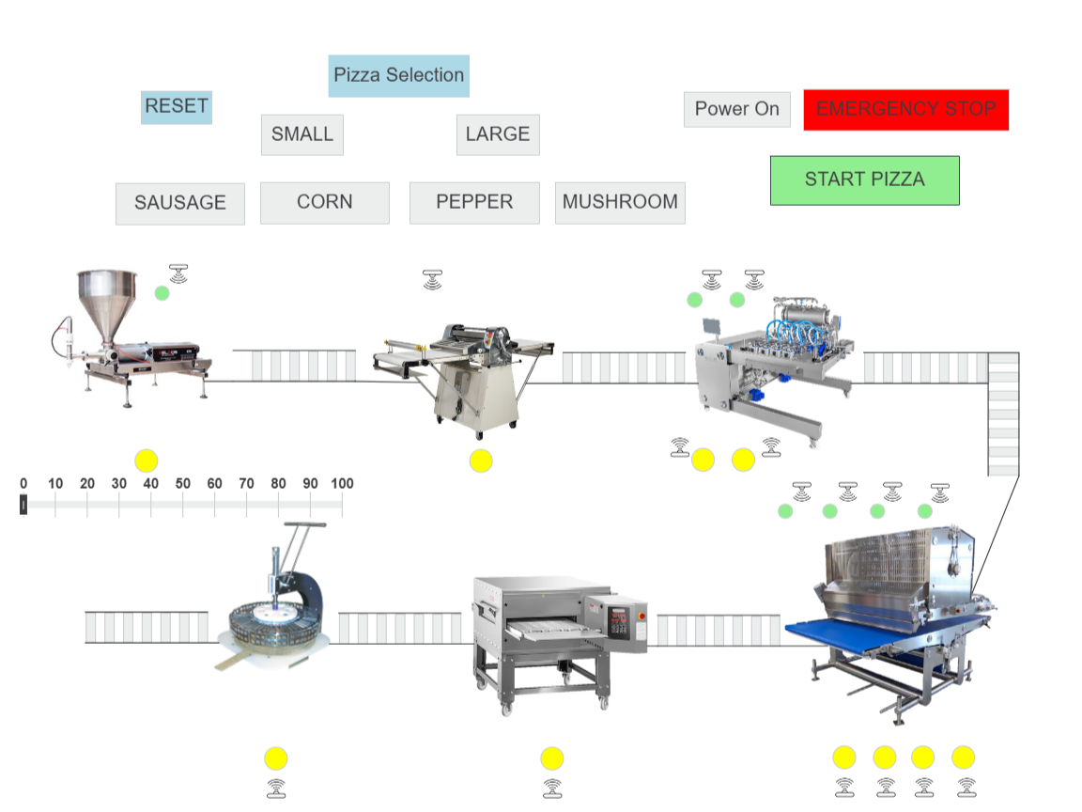
HMI

Slide 3
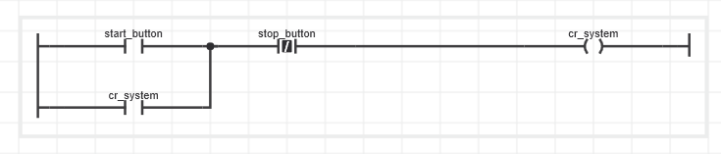
Ladder Diagram of System Power on & Power off (Classic latch)

Slide 4
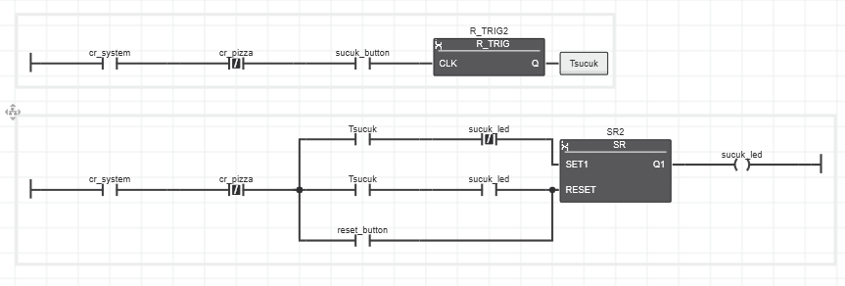
Pizza customization

Slide 5
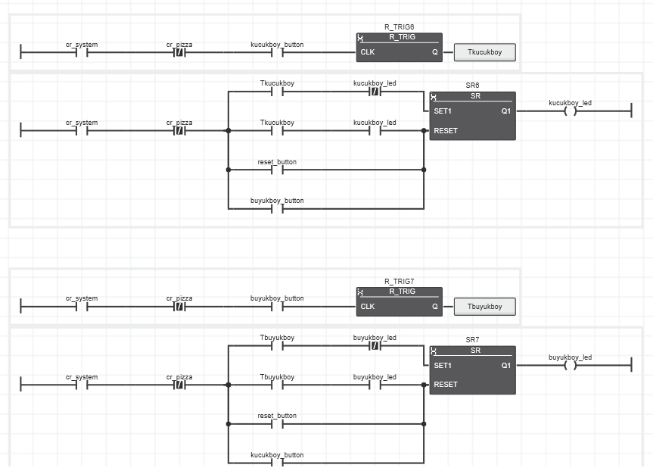
Pizza size selection

Slide 6
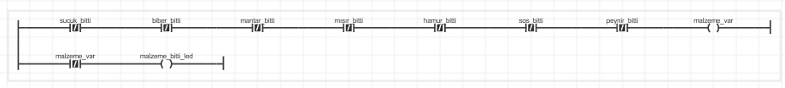
Check if there is enough ingredients

Slide 7
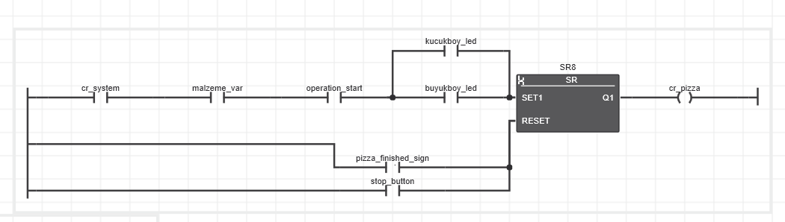
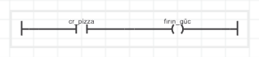
Start making pizza & Pre-heat the oven

Slide 8
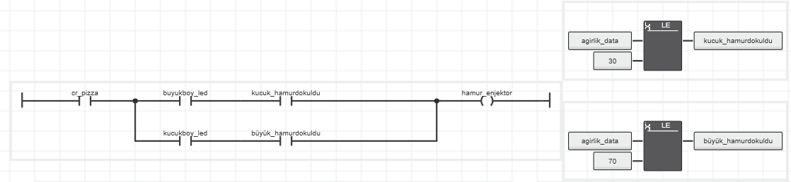
Pour the dough

Slide 9
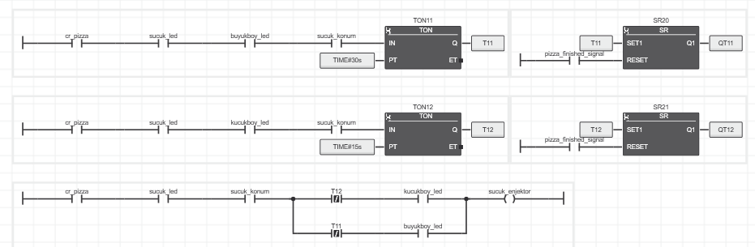
Add ingredients to pizza

Slide 10
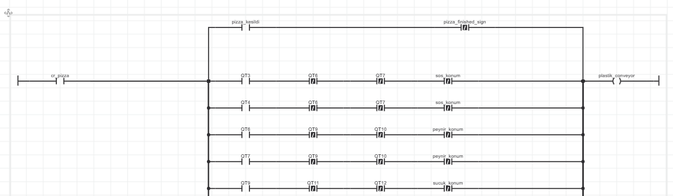
Control plastic conveyor belt

Slide 11
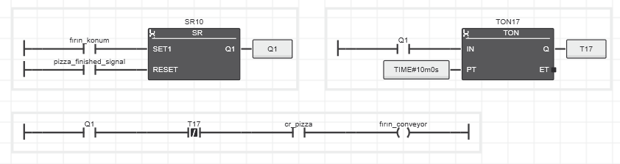
Control the oven conveyor

Slide 12
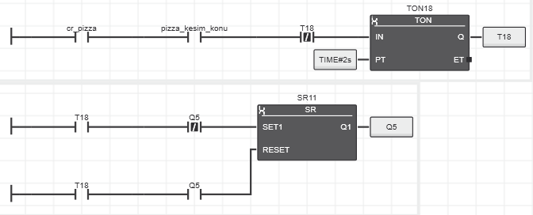
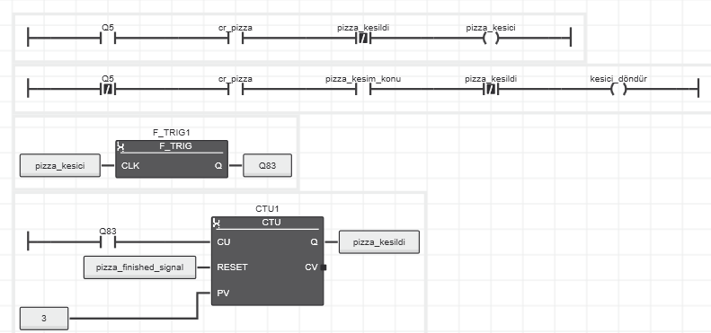
Slice the pizza and it is ready to eat

Slide 13

HMI VIDEO

